Slide 1
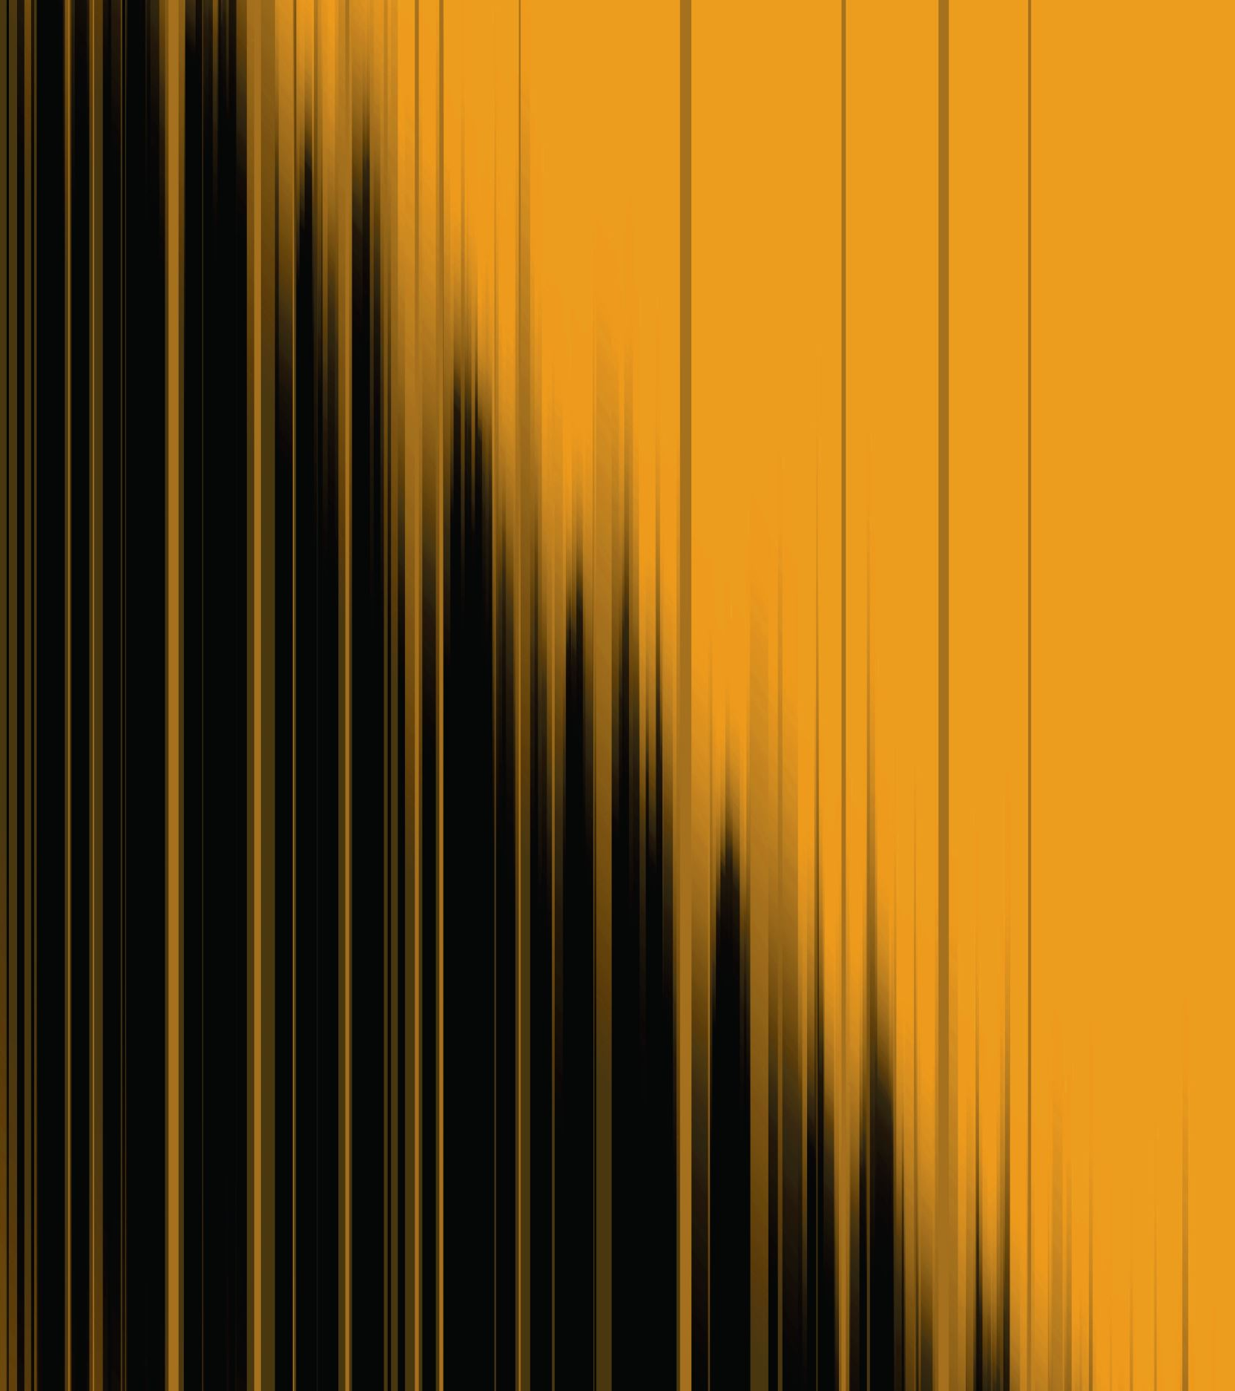
ABM for Marketing Research
ABM Modelling version 0.1

Slide 2
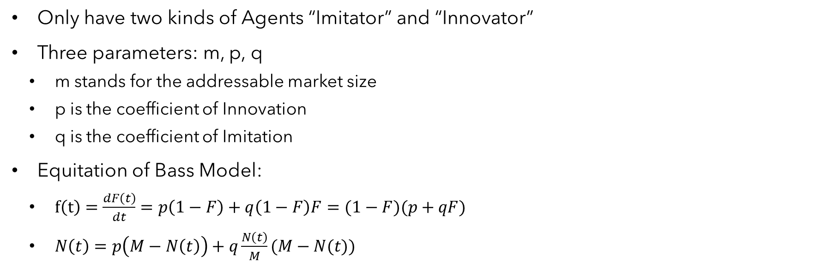
Bass Model Theory
Only have two kinds of Agents “Imitator” and “Innovator”
Three parameters: m, p, q
m stands for the addressable market size
p is the coefficient of Innovation
q is the coefficient of Imitation
Equitation of Bass Model:
$f\left(t\right)=\frac{dF\left(t\right)}{dt}=p\left(1−F\right)+q\left(1−F\right)F=(1−F)(p+qF)$
$N\left(t\right)=p\left(M−N\left(t\right)\right)+q\frac{N\left(t\right)}{M}(M−N(t))$

Slide 3
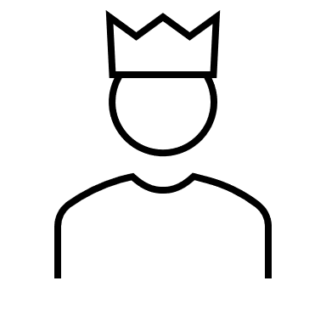

Treat P and Q as probabilities in ABM
Probability of p to become an acceptor
Innovator
Probability of q to follow his/her neighbor around them
Imitator

Slide 4
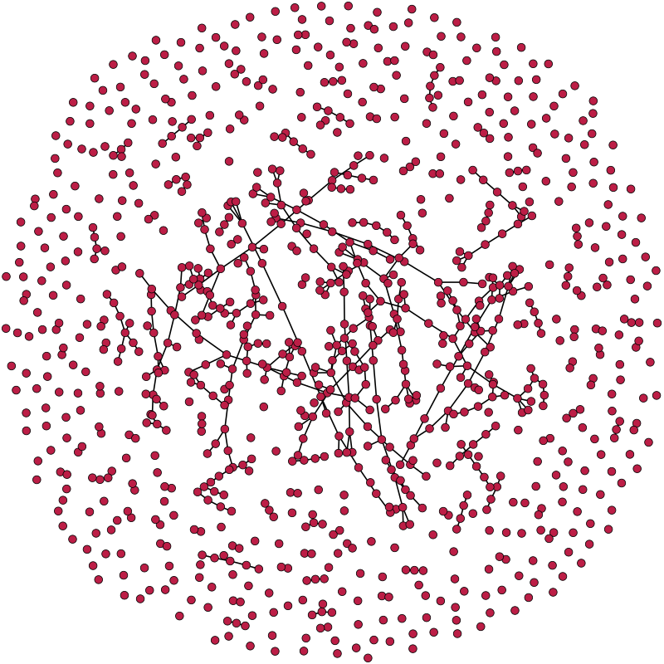
How to define Network (Neighbor)
With Erdos-Renyi Model
A random network just need to know the total nodes and the probability of the edge between two nodes
Initial Agents’ neighbor by this network
Can find this python implementation in the Library “networkx”

Slide 5
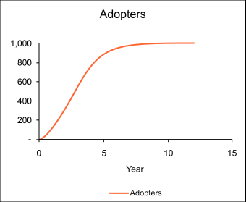
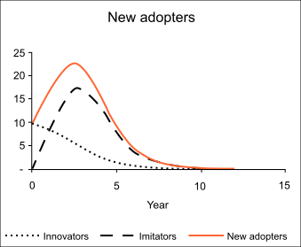
Pure Bass Model’s Result

Slide 6
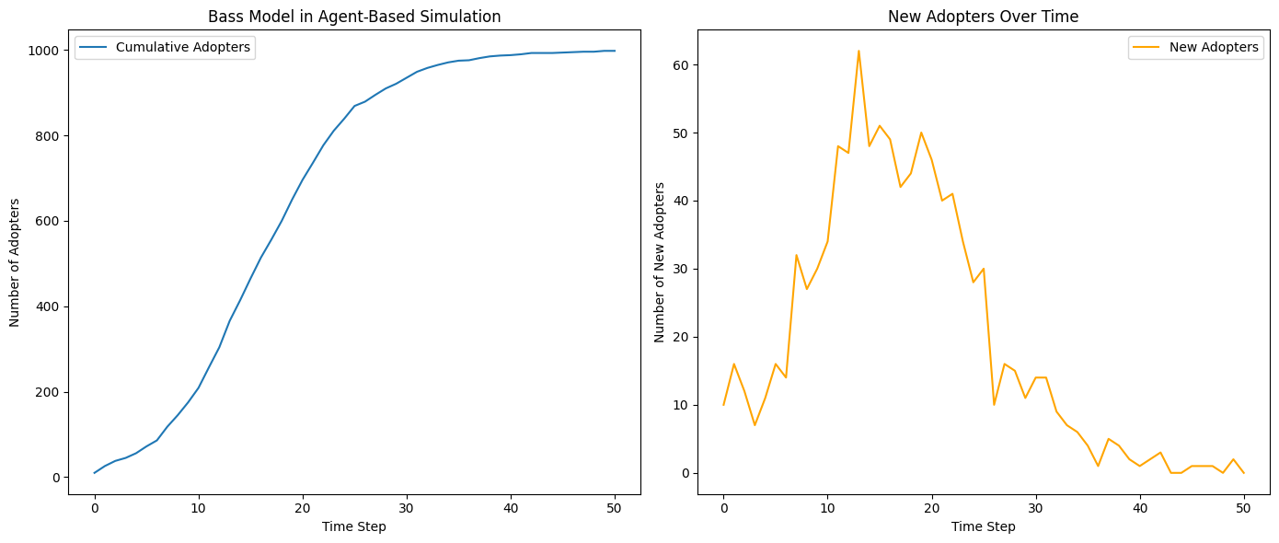
Using numpy and networkx to simulate

Slide 7
My Questions – Model Design
Like the online shopping scenario:
How to design the model with other agents like the influencers and sellers
For Influencers
Have higher Innovation
More neighbors (so I need to redefine the network)
Interaction with sellers?
For Sellers
The volume of the market may change
Interaction with Influencers and Regular Users
A new product couldn’t be always successful

Slide 8
My Questions – Visualization
What to show in the Result Analysis
Total Acceptors and New Acceptors in each time stamp
The adoption probability of each agent changes
I have no ideas with others
What about showing the cookiecutter dashboard
The ABM world Design?

